Slide 1


LET'S LEARN ABOUT
GARBO

Slide 2
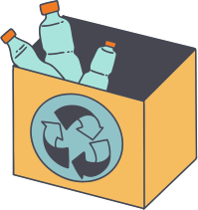
OUR OBJECTIVE
Intelligent recycling solution
Solve problems with house waste management

Slide 3
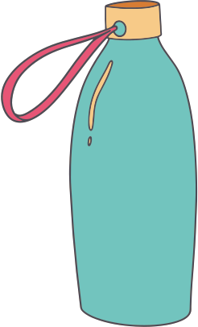

CONCEPTUAL DESIGNS

Slide 4
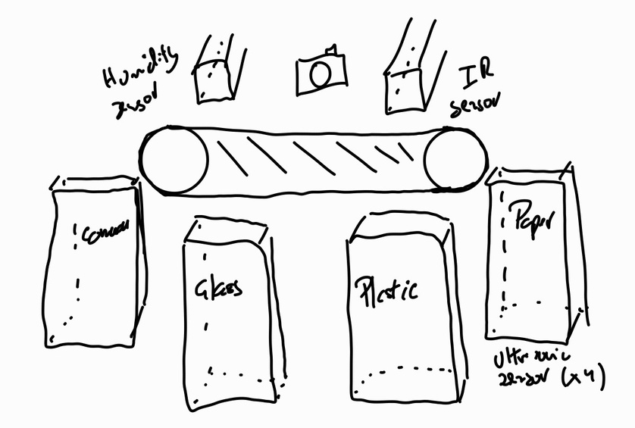
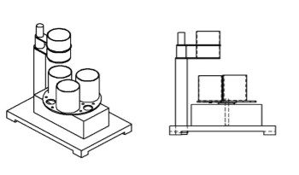
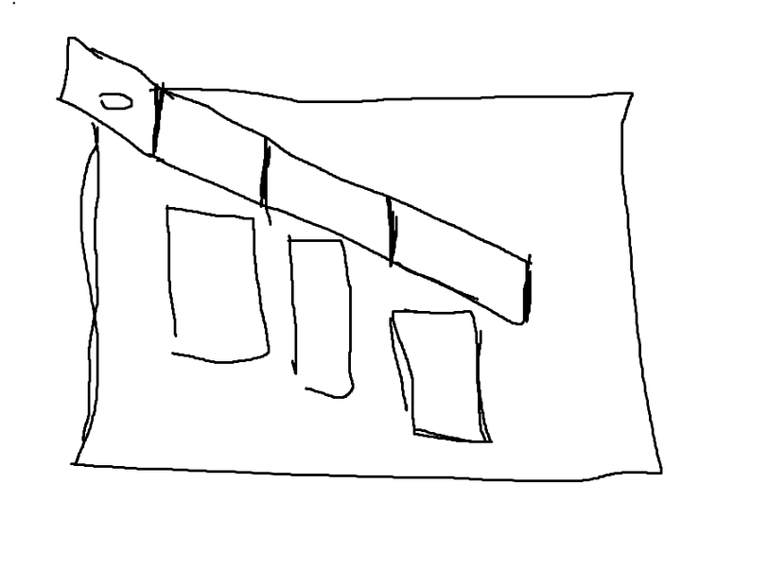
IDEA 1
IDEA 2
IDEA 3

Slide 5


HOW IT WORKS
Paper
Plastic

Slide 6
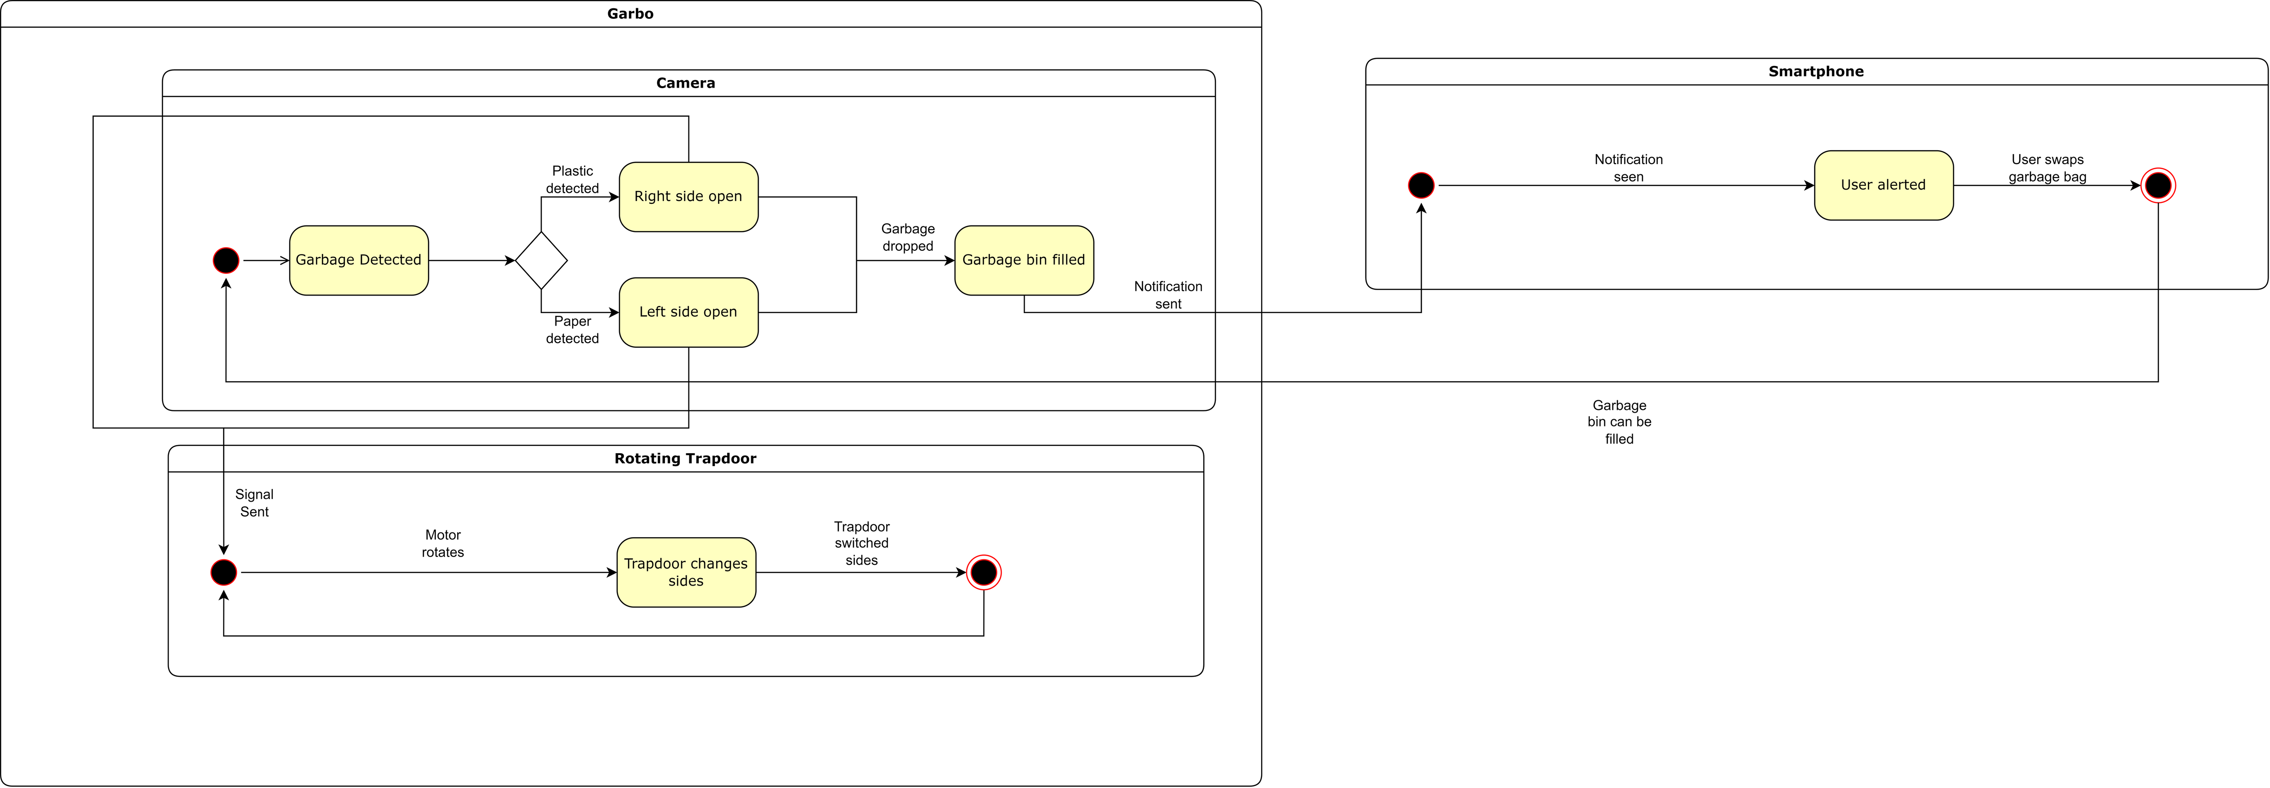

Slide 7
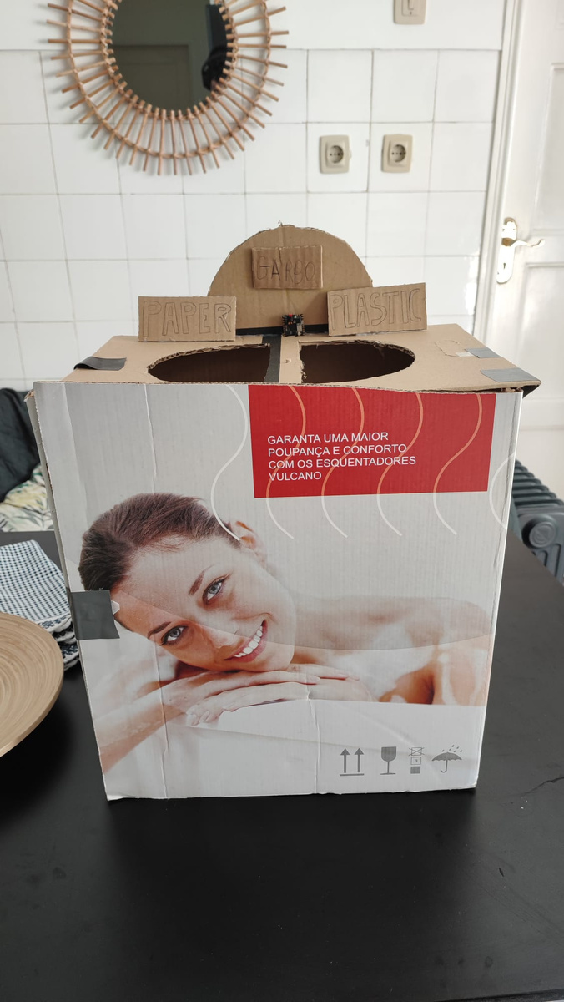
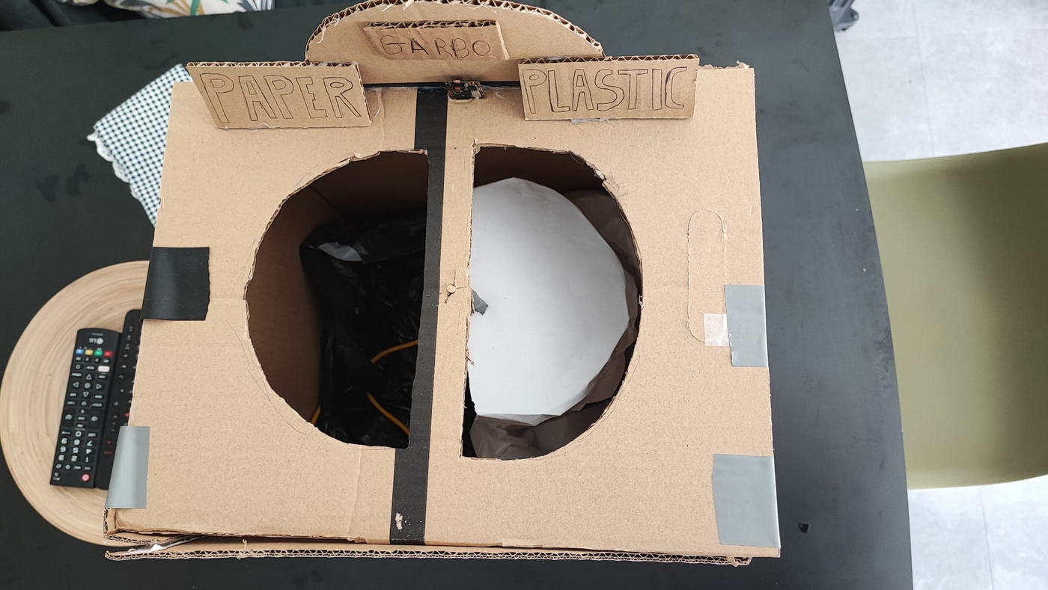
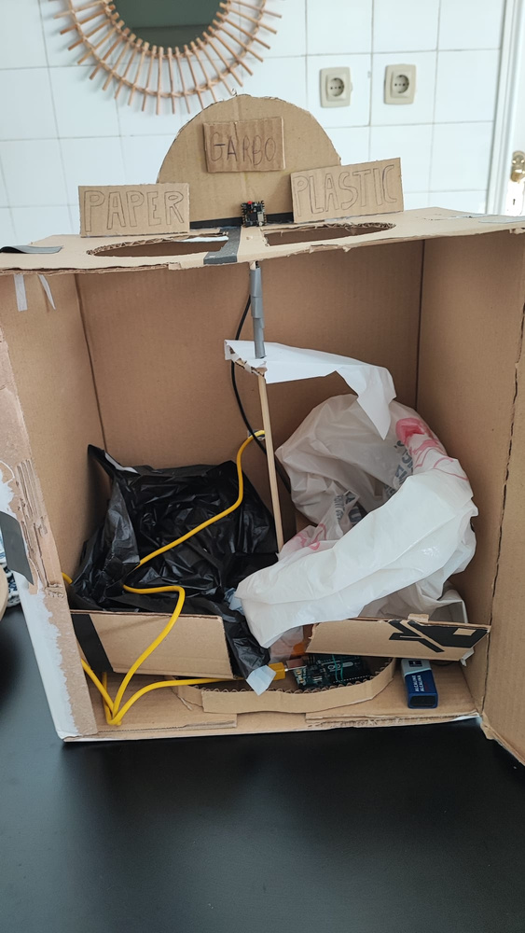
FINAL DESIGN

Slide 8

DIFFICULTIES

Slide 9
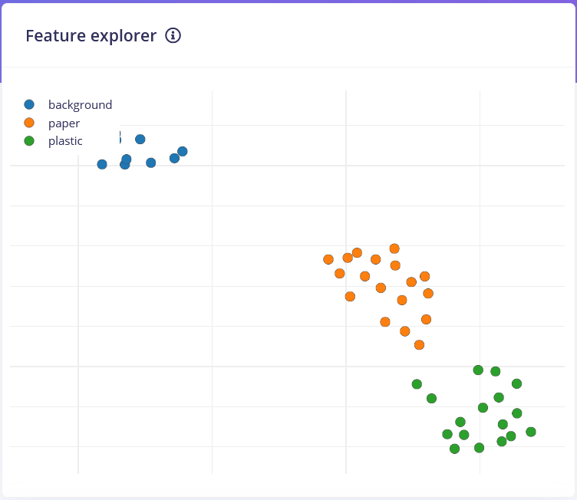
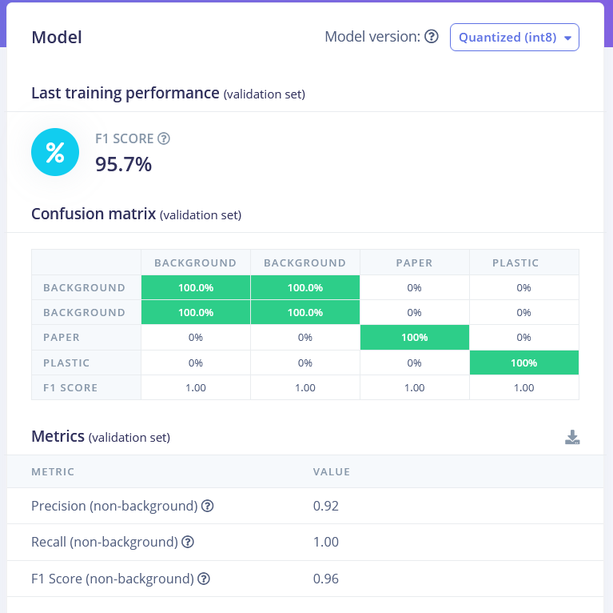
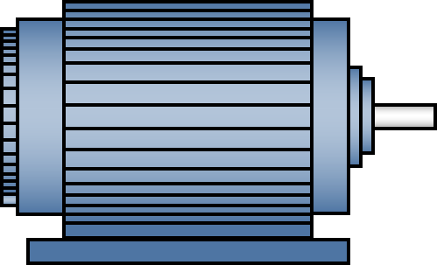

Slide 10

VIDEOS

Slide 11
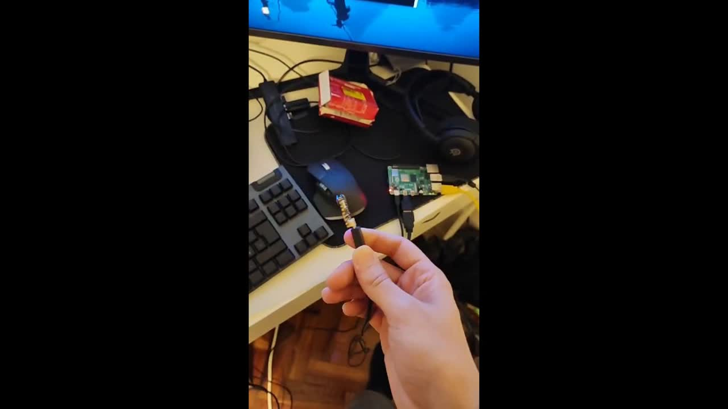

Slide 12

CONCLUSION

Slide 13

QUESTIONS?

